Slide 1
Object Diagrams
Object diagrams model the instances of things contained in class diagrams. An object diagram shows a set of objects and their relationships.
We use object diagrams to model the static design view or static process view of a system.
Object diagrams are not only important for visualizing, specifying, and documenting structural models, but also for constructing the static aspects of systems through forward and reverse engineering.

Slide 2
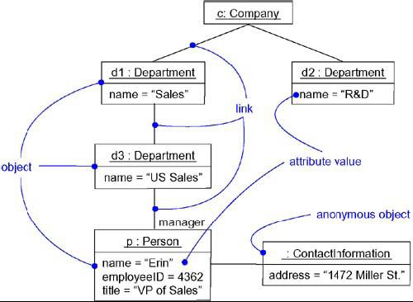
Object Diagram

Slide 3
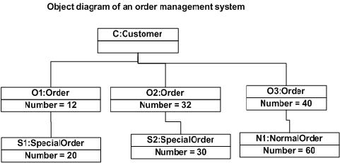

Slide 4
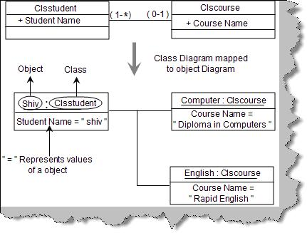

Slide 5
An object diagram is a diagram that shows a set of objects and their relationships at a point in time.
Graphically, an object diagram is a collection of vertices and arcs.
An object diagram is a special kind of diagram and shares the same common properties as all other diagrams that is, a name and graphical contents that are a projection into a model.

Slide 6
Object diagrams commonly contain
Objects
Links
Like all other diagrams, object diagrams may contain notes and constraints.
Object diagrams may also contain packages or subsystems, both of which are used to group elements of your model into larger chunks.

Slide 7
Object diagrams to model the static design view or static process view of a system just as you do with class diagrams.

Slide 8
When you model the static design view or static process view of a system, you typically use object diagrams in one way:
To model object structures:-
Modeling object structures involves taking a snapshot of the objects in a system at a given moment in time.
object diagrams are used to visualize, specify, construct, and document the existence of certain instances in your system, together with their relationships to one another.

Slide 9
Common Modeling Techniques
Modeling Object Structures
Identify the mechanism you'd like to model. A mechanism represents some function or behavior of the part of the system you are modeling that results from the interaction of a society of classes, interfaces, and other things.
For each mechanism, identify the classes, interfaces, and other elements that participate in this collaboration; identify the relationships among these things, as well.

Slide 10
Consider one scenario that walks through this mechanism. Freeze that scenario at a moment in time, and render each object that participates in the mechanism.
Expose the state and attribute values of each such object, as necessary, to understand the scenario.
Similarly, expose the links among these objects, representing instances of associations among them

Slide 11
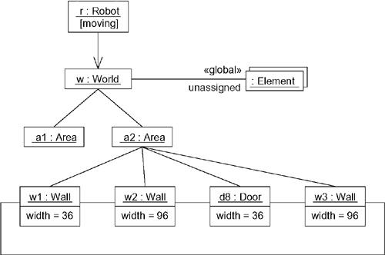

Slide 12
Forward and Reverse Engineering
Forward engineering (the creation of code from a model) an object diagram is theoretically possible but pragmatically of limited value. In an object-oriented system, instances are things that are created and destroyed by the application during run time. Therefore, you can't exactly instantiate these objects from the outside.

Slide 13
Reverse engineering (the creation of a model from code) an object diagram is a very different thing.

